Slide 1


Slide 2
RESEARCH RESULTS „ BRIDGE - DEMENTIA PREVENTION AND THERAPY”
ONE OF THE MAIN AIMS OF WBF, EBL AND NBOs SHOULD BE PROMOTION OF OUR GAME
IT SEEMS TO ME THAT THIS AIM IS NOT TREATED WITH DUE SERIOUSLY ENOUGH
IN MY OPINION
ONLY WBF HAS PROMOTION FUND EVERY YEAR

Slide 3
EBL STATUTES
3. AIMS OF THE EBL
The objects of the EBL are to: a) Promote bridge in Europe and Zone 1;
QUESTION IS : HOW TO DO IT ?

Slide 4
TWO YEARS AGO IN PRAGUE IN MY PRESENTATION I TOLD YOU THAT SOME RESEARCH ARE JUST RUNNING ON :
- BRIDGE AS DEMENTIA PREVENTION
- BRIDGE AS THERAPY FOR MCI PATIENTS OF ALZHEIMER
CENTER IN WARSAW
AS LONG AS I REMEMBER YOU HAVE FOUND THEM
INTERESTING NOT ONLY FOR BRIDGE PROMOTION

Slide 5
DESPITE PROBLEMS CREATED BY PANDEMIA OUR PILOT RESEARCH IS NOW COMPLITED
FULL RESULTS , COMMENTS AND OUR PLANS YOU CAN FIND ON WWW.BRIDGETOTHEPEOPLE.EU
ON THAT BASE WE STARTED MAIN RESEARCH TO MAKE RESULTS STRONGER
DISPATE THAT CONTINUOSLY WE LIVE WITH COVID ALL OUR PLANS STAY VALID

Slide 6
WHAT WE FIND OUT IN OUR RESEARCH ?
PENSIONERS OF SOCIAL WELFARE HOUSE INITIALLY ON PATHOLOGICAL DEPRESSION , AFTER 20 WEEKS OF BRIDGE LESSONS AND SUPERVIZED PLAY , ALMOST CAME OUT OF DEPRESSION AND THEIR WELLBEING INCREASED STATISTICALLY SIGNIFICANTLY.
WE USED TO MEASURE BOTH PARAMETERS : GERIATRIC DEPRESSION SCALE AND PROF.MARTIN SELIGMANS PERMA SCALE
AND ALL OF THEM KEEP PLAYING !!

Slide 7
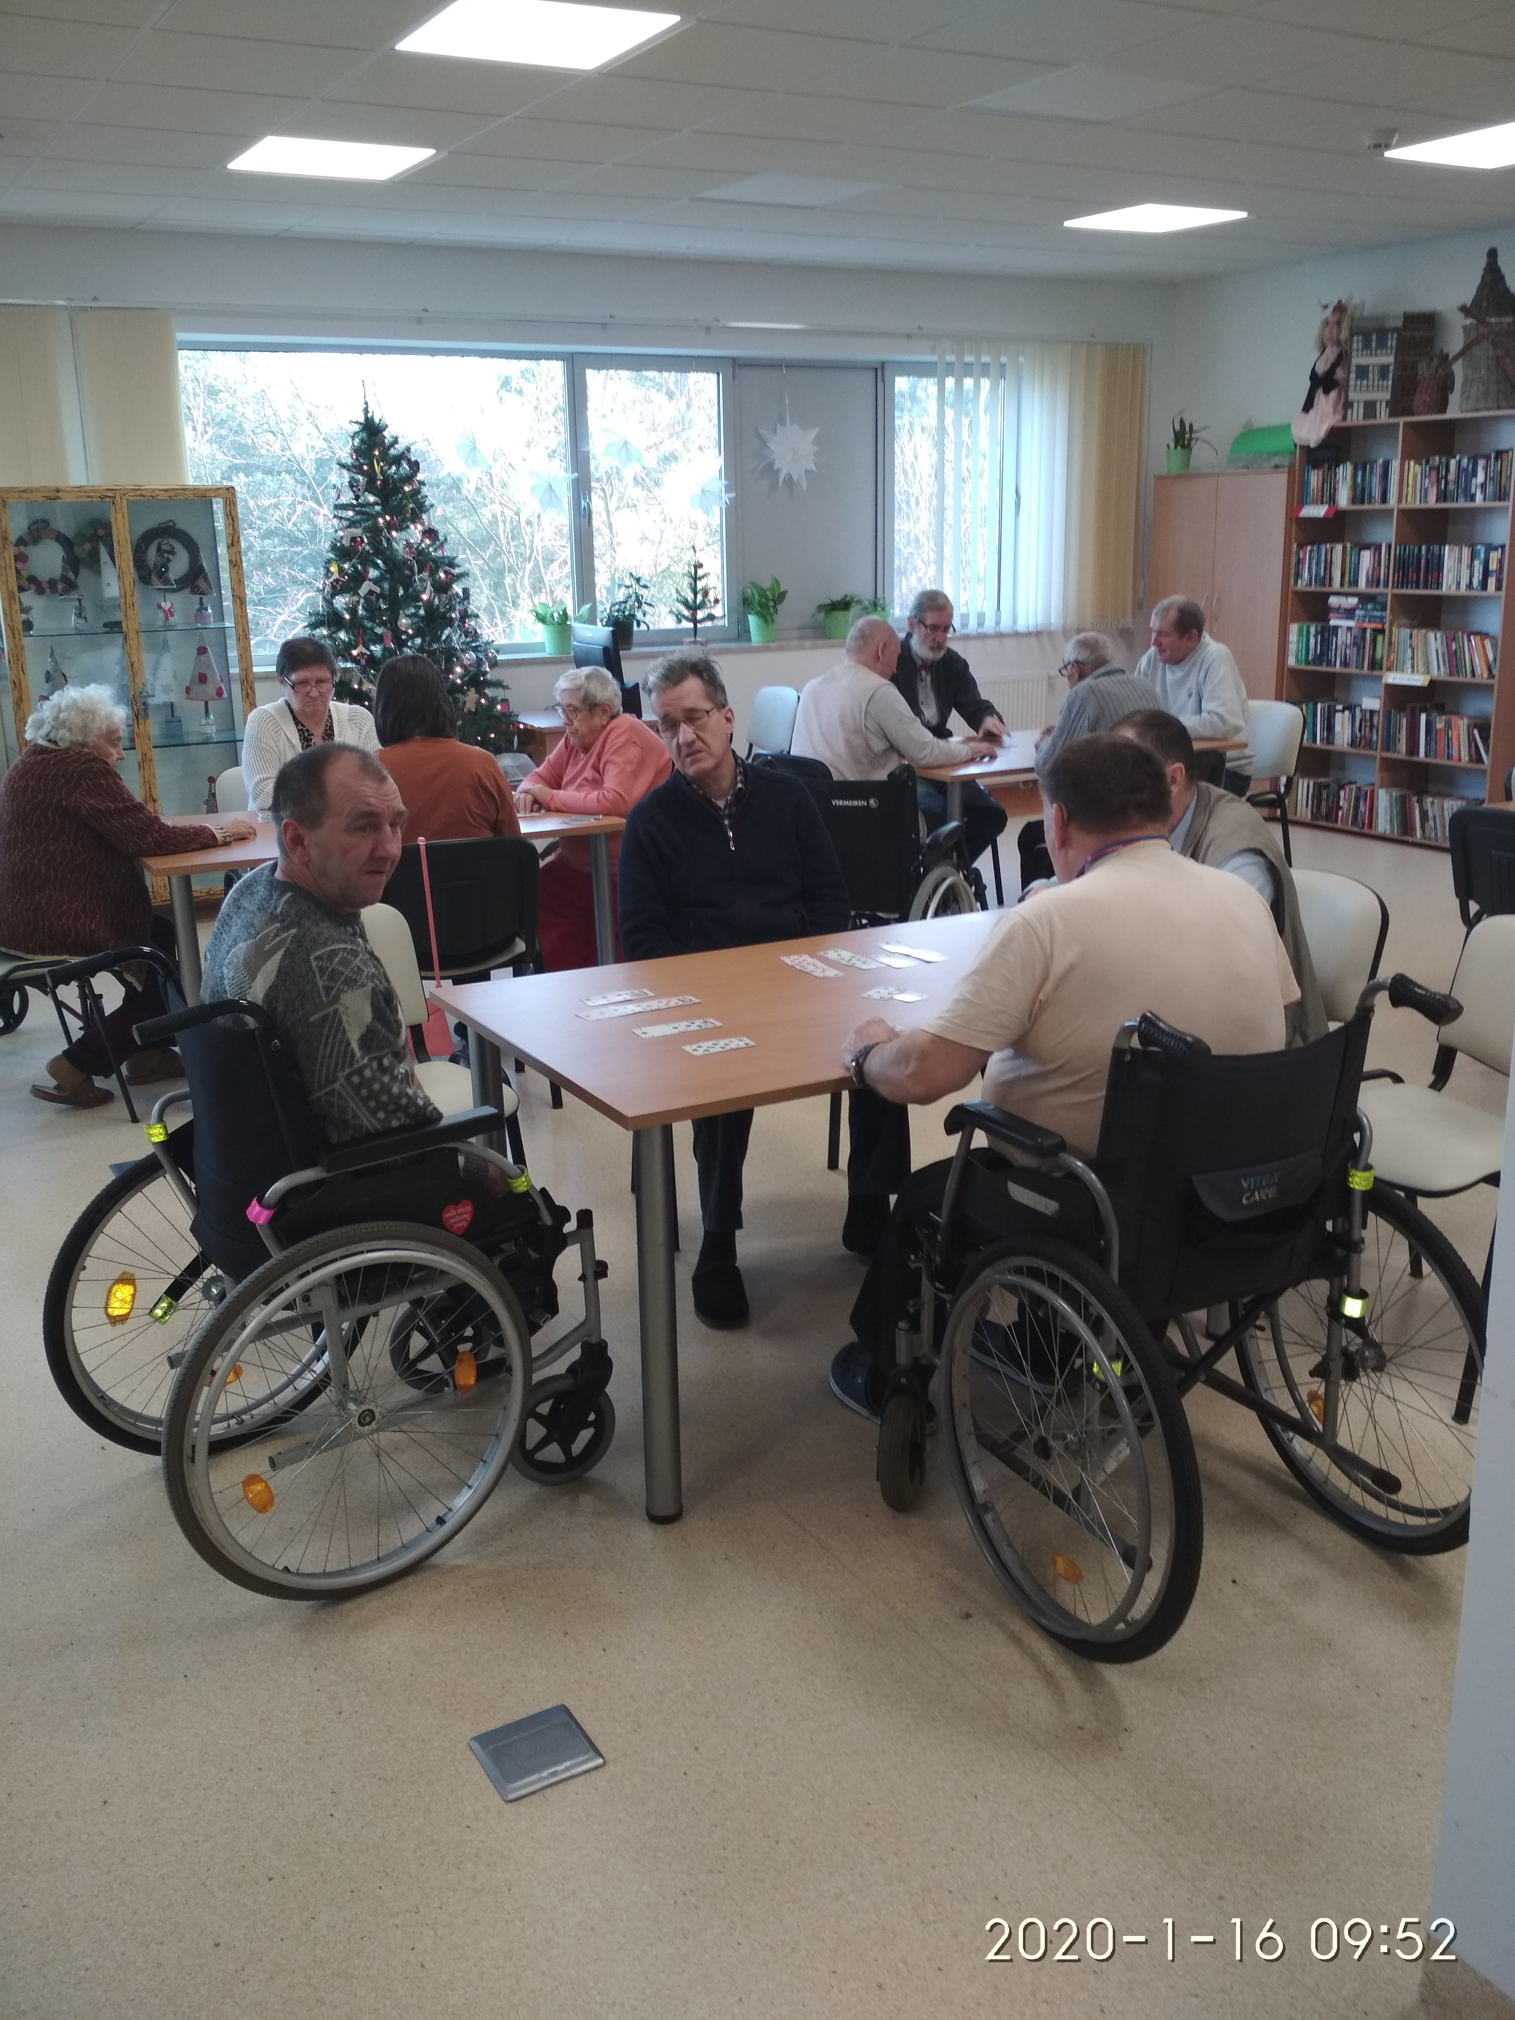

Slide 8
IN ALZHEIMER CENTER WE TEACHED SIMPLIFIED BRIDGE TO PATIENTS WITH MILD COGNITIVE IMPAIRMENT (BEFORE CLINICAL STAGE OF DISEASE)
CONTROL GROUP HAD NORMAL SET OF MANUAL AND MENTAL THERAPIES WHILE BRIDGE GROUP HAD ADDITIONAL BRIDGE 2,5 HOURS A WEEK
AFTER ONE YEAR LOSS OF COGNITIVE ABILITIES IN CONTROL GROUP WAS CA 2,5 TIMES HIGHER
WE USED MINI MENTAL STATE EXAMINATION TO MEASURE IT

Slide 9
WITH PROBABILITY OF 95% RESULT IS NOT INCIDENTAL SO IT IS STATISTICALLY IMPORTANT!
IN MEDICAL RESEARCH WE ARE TALKING ALSO ABOUT CLINICAL IMPORTANCE OF RESULTS AND OUR FINDINGS ARE CLINICALLY IMPORTANT !
BRIDGE BECAME OFFICIAL THERAPY !!
CAN IT BE GOOD PROMOTION FOR OUR GAME?
THEY ALSO KEEP PLAYING

Slide 10
AS I ALREADY TOLD YOU EARLIER TODAY FOUNDATION„BRIDGE TO THE PEOPLE” KEEPS RUNNING RESEARCH IN :
- 6 ALZHEIMER CENTERS
-10 SOCIAL WELFARE HOUSES
RESULTS OF MAIN RESEARCH WE HOPE TO PRESENT DURING FIFTH INTERNATIONAL SCIENTIFIC CONFERENCE „AGING WELL”AGAIN IN TORUN IN DECEMBER 2022.
WE ARE OPEN FOR KIND OF SUPPORT AND COOPERATION.

Slide 11
MARGARET MARUSZKIN FROM PBU , THE ONE WHO DIRECTED ME TO MAKE EXPERIMENT IN ALZHEIMER CENTER IS TRYING TO ORGANIZE VERY FIRST INTERNATIONAL BRIDGE EVENT FOR :
BLING PLAYERS
FROM GREECE, NETHERLANDS AND POLAND

Slide 12
YOU ARE ALSO INVITED FOR CONFERENCE WHERE YOU CAN PRESENT YOUR OPINIONS AND PERHAPS RESEARCH RESULTS?
WBF „BRIDGE AND SCIENCE” COMMITTEE IS OPEN FOR ANY COOPERATION. WE HAVE HERE ITS MEMBERS PROF..SAMANTHA PUNCH AND ME AND OTHER MEMBERS ARE VERONIQUE VENTOS (NukkAI) , PIOTR BŁAJET ( PHISIOLOGY OF SPORT) AND P.W.GABRIELE ( NEUROLOGIST). WE WOULD LIKE TO WELCOME ALSO OTHER SCIENCE .

